Slide 1




Data-Driven Launch Strategy For Rockbuster Stealth
Anish Matta
BI Analyst

Slide 2

Marketing Strategy
Optimization
Research
Planning

Slide 3
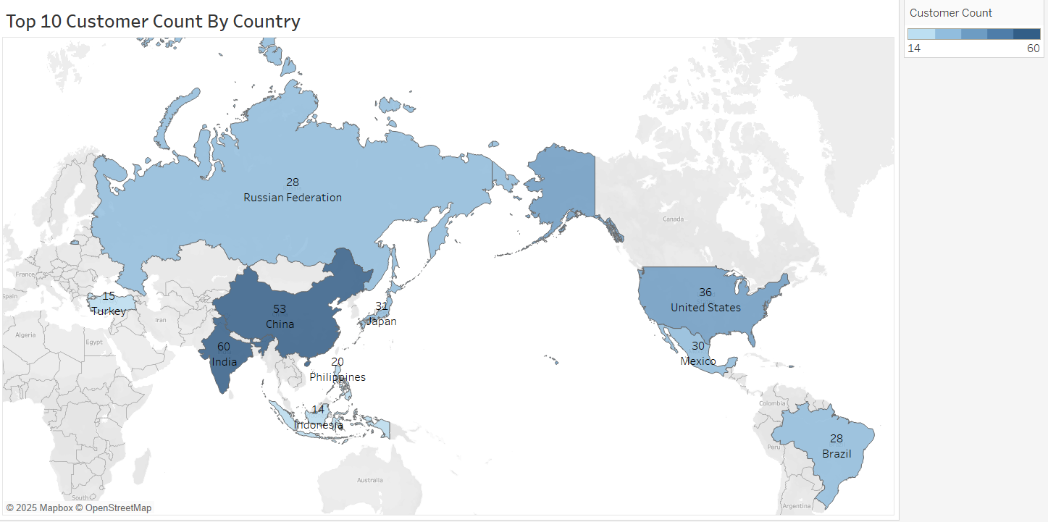
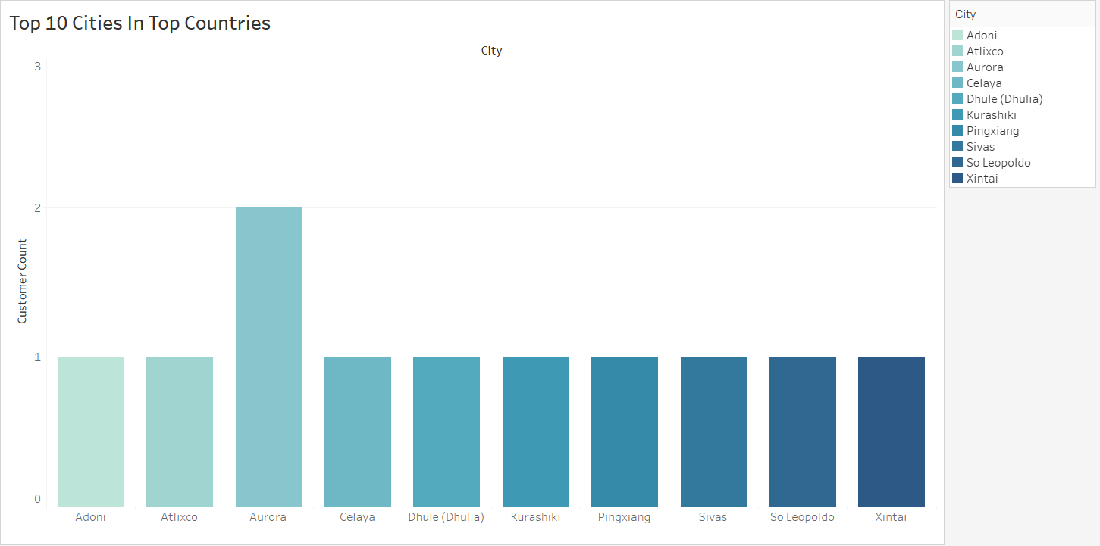
Location Statistics
As you can see the darker shaded countries have the higher customer count. It is led by India (1st) and China (2nd), followed by the United States (3rd). Next to the countries visualization are the top cities in those countries.

Slide 4
Rental Duration Statistics
Minimum
3 Days
Median
5 Days
Average
5 Days
Maximum
7 Days
The typical rental duration for all videos was 5 days, ranging from a minimum of 3 days to a maximum of 7 days. By promoting shorter rental periods, the turnover rate of movies can be boosted, enabling each title to be rented more frequently within a set timeframe.

Slide 5

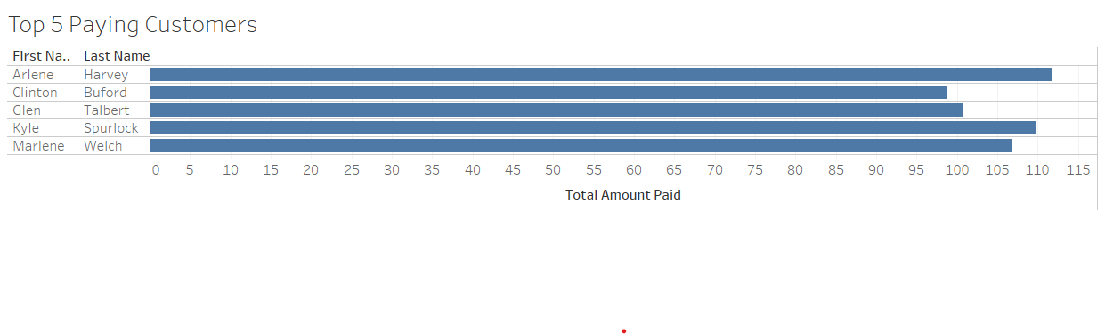
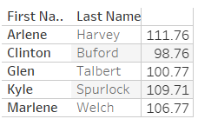



Highest Paying Customers
Here we can see the top 5 highest paying customers. To boost sales, we can have a promotion for the highest paying customers every month. Adding a simple gift such as free movie rentals or merchandise can boost sales and make customers more interested.

Slide 6

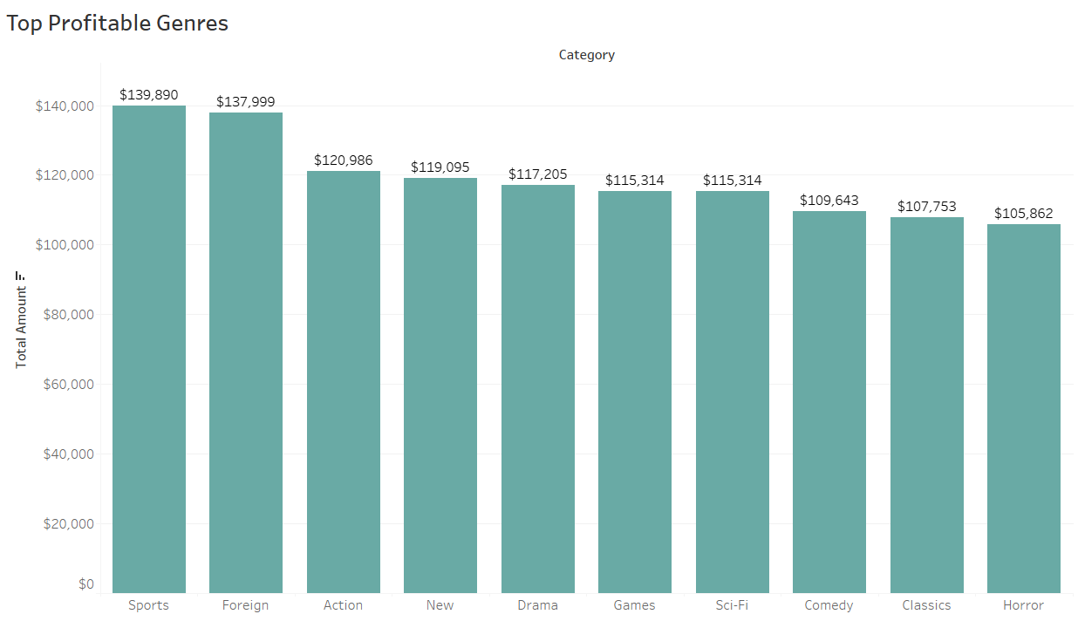
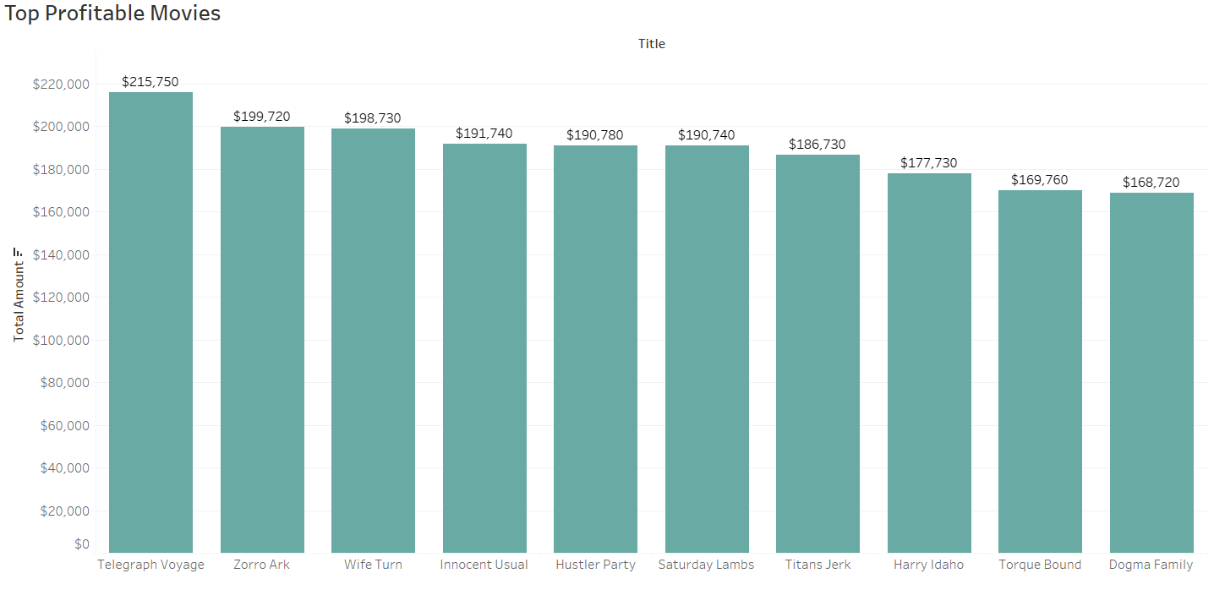
Movie Revenue Statistics
From the visualization we can see that the top three profitable genres are “Sports”, “Foreign”, and “Action”. Next to that is a visualization of the top movies. We should focus on the most profitable genres but continue with less performing genres as there isn’t a massive discrepancy.

Slide 7

Insights/Recommendations For Future
Focus on top markets. India, China, and the United States make up most of the customers so there should be higher marketing presence there.
Launch new campaigns and marketing in Russia, Mexico, and Brazil as they are upcoming and have the potential to generate a ton of revenue.
Create a loyalty/incentive program for the highest paying customers per month.
Focus on the top genres, but don’t just give up on lower performing genres. See why the top movie titles are so popular and try to replicate that. Tailor rental rates and duration to best match customer preferences.

Slide 8

Thank You!
I appreciate your time taken to go over this presentation.
Please let me know if you have any questions or concerns.
Contact Information: Rockbuster Stealth: BI Analyst: Anish Matta xxx@gmail.com

